Slide 1
Infrastructure as a Service Overview
Hyunsuk Shin (hyssh@microsoft.com)
MTC Seattle

Slide 2

IaaS Services
Notes:
What we will talk about today are some of the technologies and services that constitute Infrastructure as a Service

Slide 3
Core services of Azure IaaS
Compute
Storage
Networking
Management
Virtual machines
Availability sets
VM Scale Sets
Disks (Standard, premium)
Blob storage (Hot, cool)
Files
Virtual networks
VPN, ExpressRoute
Load Balancer
DNS, Traffic Manager
Azure Resource Manager (ARM)
Azure Active Directory
Portal
KeyVault
Notes:
Taking a deeper look at some of the key services that constitute Azure IaaS. We will go into a little bit more detail into each of these services
The four core technologies are Compute, Network, Storage and Management
Compute:
Virtual Machines is no different from the Virtual Machines you run on premise
We will go into the concept of Availability sets that provides you better availability on the platform. Create available solutions. 99.95%
- VM Scale sets, for autoscaling. VM extensions – custom run scripts
Network:
Virtual network similar to on-prem allow VMs to connect on a private network in the cloud. It provides an isolated and secure environment for your applications.
We have different types of connectivity – IPSec VPN or ExpressRoute (private network on a telecom provider, highest level of security)
Bring your own network to Azure, most of the networking technologies you are familiar with are available on Azure
There are different ways to connect to Azure such as VPN, ExpressRoute that we will talk about
We will also talk about features like Load balancing, DNS
What does Traffic manager do – distribute traffic
Storage:
Azure Storage offers different sets of storage services for various business needs. Some of them being disks connecting to a VM or Blob storage for unstructured data
VMs connect to Disks – there are different options Standard or Premium disks based on whether you want higher throughput and lower latency
We have object storage for your storage needs. We recently launched also Cool storage if you don’t need frequent access
Management
Management across the these various foundational services. Some of the services including portal, AD, MFA, Keyvault, marketplace.
Security
AD for identity management
ARM management, powerful - templatized

Slide 4

Compute families
A
Compute
Storage
Networking
Management
Highest value
A
D
F
G
A
D
E
F
G
A
Highest value
SSD Storage Fast CPUs
Compute
Optimized VMs
Most memory fastest CPUs
>80,000 IOPs
Premium Storage
Highest value
Entry Level VMs
Dev/Test workloads
General Purpose VMs
Common applications, web servers, etc.
Memory optimized
Nested Virtualization
Compute Optimized VMs
Gaming, analytics
Large Memory VMs
Large databases
A
H
L
N
Highest value
High Performance VMs
Storage optimized VMs
GPU-enabled VMs
SAP HANA sizes
H
L
M
N
A
Fastest VMs on Azure with Intel Haswell E5 processor
Supports RDMA and high memory
For high performance, fluid dynamics
Based on Intel Xeon E5 processor
Supports 8GB RAM and 768 GB to 6TB SSD
For Low latency, Storage Optimized workloads
NVIDIA Tesla accelerated platform and GRID 2.0
Supports RDMA
For Compute and Graphics intensive workloads
Available with G and D series
Highest value
Doubling our Compute Instances Portfolio
High Performance VMs
Batch processing, fluid dynamics, Monte Carlo simulation
Storage optimized VMs
No SQL databases (Cassandra, MongoDB), data warehousing
Large VMs
Nested Virtualization
128 Cores, 2 TB RAM
GPU-enabled VMs
Graphic based applications, remote visualization
SAP HANA Large instances
OLTP, OLAP
A
Largest machines supporting Enterprise grade workloads
Highest value
Notes:
With all of the infrastructure we have set up, you can tap into incredible compute capacity to run your applications. Let me talk about the compute offerings we have. When your run your applications in Azure, you’ll most likely be using Virtual Machines. These are no different than VMs you use in your own datacenters – in fact, we run a version of Hyper-V and are able to take VHDs and run them. Virtual Machines give you on-demand compute infrastructure, run Windows or Linux, and come in a variety of sizes.
This infrastructure – exposing as VMs to you guys. Comes in these flavors: ADFG
VMs: business payoff – scale, pay as you go, compute is biggest cost, spinning up VMs in minutes (not days) – enables developers to go faster.
Add in bullet points on slide: value prop
Pay for only what you use, scale to your needs, enable developers
With all of the infrastructure we have set up, you can tap into incredible compute capacity to run your applications. Let me talk about the compute offerings we have. Slide 29-30: Compute sizes (1 minute) * When your run your applications in Azure, you’ll most likely be using Virtual Machines. These are no different than VMs you use in your own datacenters – in fact, we run a version of Hyper-V and are able to take VHDs and run them. Virtual Machines give you on-demand compute infrastructure, run Windows or Linux, and come in a variety of sizes. *
A – our earliest generation and offer high value, meant for dev/test workloads *
D – production grade general purpose VMs with a good combination of CPU, memory and local SSD for most common applications *
F – we recently introduced – have higher CPU to memory ratio and are for compute intensive applications like gaming or analytics *
G – Very large VMs with 0.5TB RAM and 32 Intel CPUs for large databases * Premium storage is our High OPS storage (>80k IOPS) can be used with the VMs for workloads that require very fast storage -like SQL or noSQL databases
IO and Compute intensive large SQL and noSQL databases, SAP and other demanding business apps

Slide 5
Azure Storage
Compute
Storage
Networking
Management
Blobs
“Highly scalable, REST-based cloud object store”
Hot and Cool Tier
Tables
“Massive auto scaling NoSQL store”
Queues
“Reliable messaging at scale for cloud services”
Files
“SMB File Share”
SMB 3.0
Read/Write multiple VMs
Blobs
“Highly scalable, REST-based cloud object store”
Hot and Cool Tier
Tables
“Massive auto scaling NoSQL store”
Queues
“Reliable messaging at scale for cloud services”
Premium disks
SSD based, high IOPS, low latency
Up to 64 TB, 80000 IOPs
Files
“SMB Access to Azure Storage”
Premium disks
SSD based, high IOPS, low latency
Up to 64 TB, 80000 IOPs
Standard disks
Magnetic disks, HDD based. Up to 500 IOPs/disk
Standard disks
Magnetic disks, HDD based. Up to 500 IOPs
Azure Import/Export
AZCopy
ExpressRoute
Data transfer options
Notes:
Speaker Notes:
Azure Storage is comprised of many storage types including Blobs, Tables, Queues, Premium and Standard Disks and Files. Azure Storage:
Enables you to manage petabytes of storage
Provides geo-redundant storage across hundreds of miles
Delivers the fastest performance in the industry
Provides industry standard SMB file sharing across virtual machines
Empowers you to pay for what you use with competitive pricing
Allows you to use REST, .NET, Java, C++, node.js, PowerShell and more
Standard Disks – magnetic
Premium Disks – higher IOPs
Two types of Blob – Hot for frequent access, Cool for infrequent access and can save money
Files – SMB file share for legacy application 3.0. file sharing between VMs using Windows APIs and File Service Rest API
Blobs, Tables, Queues, and Files
Azure Storage provides the flexibility and hyper-scale needed to store and retrieve large amounts of data. Use Azure Blob Storage to store unstructured data, such as documents and media files, Azure Table Storage to store structured NoSQL data, and Azure Queue Storage to reliably store messages. Use SMB-based Azure File Storage for existing or new applications - no code changes are required.
Premium Storage
Azure Premium Storage delivers high-performance, low-latency disk support for I/O-intensive workloads running on Azure virtual machines. You can attach several Premium Storage disks to a virtual machine. With Premium Storage, your applications can have up to 64 TB of storage per virtual machine and achieve 80,000 IOPS (input/output operations per second) and 2,000 MB per second disk throughput per virtual machine with extremely low latencies for read operations. Premium Storage is currently available only for storing data on disks used by virtual machines.
Premium Storage supports only Azure page blobs, which are used to hold persistent disks for Azure Virtual Machines (VMs). For information on Azure page blobs, see Understanding Block Blobs and Page Blobs: https://msdn.microsoft.com/en-us/library/azure/ee691964.aspx. Premium Storage does not support the Azure Block Blobs, Azure Files, Azure Tables, or Azure Queues.
Many services to bring large amounts of data on-prem to the cloud
To learn more about Azure Storage visit, https://azure.microsoft.com/en-us/services/storage/.
There are also a number of data transfer options to migrate your current data to Azure. These options include Azure Import/Export, AZCopy and ExpressRoute.

Slide 6
Managed disks for VM
Compute
Storage
Networking
Management
Standard Disks Type | S4 | S6 | S10 | S15 | S20 | S30 | S40 | S50
Disk size | 32 GB | 64 GB | 128 GB | 256 GB | 512 GB | 1024 GB (1 TB) | 2048 GB (2 TB) | 4095 GB (4 TB)
IOPS per disk | 500 | 500 | 500 | 500 | 500 | 500 | 500 | 500
Premium Disks Type | P4 | P6 | P10 | P20 | P30 | P40 | P50
Disk size | 32 GB | 64 GB | 128 GB | 512 GB | 1024 GB (1 TB) | 2048 GB (2 TB) | 4095 GB (4 TB)
IOPS per disk | 120 | 240 | 500 | 2300 | 5000 | 7500 | 7500
Throughput per disk | 25 MB per second | 50 MB per second | 100 MB per second | 150 MB per second | 200 MB per second | 250 MB per second | 250 MB per second
Notes:
Speaker Notes:
Azure Storage is comprised of many storage types including Blobs, Tables, Queues, Premium and Standard Disks and Files. Azure Storage:
Enables you to manage petabytes of storage
Provides geo-redundant storage across hundreds of miles
Delivers the fastest performance in the industry
Provides industry standard SMB file sharing across virtual machines
Empowers you to pay for what you use with competitive pricing
Allows you to use REST, .NET, Java, C++, node.js, PowerShell and more
Standard Disks – magnetic
Premium Disks – higher IOPs
Two types of Blob – Hot for frequent access, Cool for infrequent access and can save money
Files – SMB file share for legacy application 3.0. file sharing between VMs using Windows APIs and File Service Rest API
Blobs, Tables, Queues, and Files
Azure Storage provides the flexibility and hyper-scale needed to store and retrieve large amounts of data. Use Azure Blob Storage to store unstructured data, such as documents and media files, Azure Table Storage to store structured NoSQL data, and Azure Queue Storage to reliably store messages. Use SMB-based Azure File Storage for existing or new applications - no code changes are required.
Premium Storage
Azure Premium Storage delivers high-performance, low-latency disk support for I/O-intensive workloads running on Azure virtual machines. You can attach several Premium Storage disks to a virtual machine. With Premium Storage, your applications can have up to 64 TB of storage per virtual machine and achieve 80,000 IOPS (input/output operations per second) and 2,000 MB per second disk throughput per virtual machine with extremely low latencies for read operations. Premium Storage is currently available only for storing data on disks used by virtual machines.
Premium Storage supports only Azure page blobs, which are used to hold persistent disks for Azure Virtual Machines (VMs). For information on Azure page blobs, see Understanding Block Blobs and Page Blobs: https://msdn.microsoft.com/en-us/library/azure/ee691964.aspx. Premium Storage does not support the Azure Block Blobs, Azure Files, Azure Tables, or Azure Queues.
Many services to bring large amounts of data on-prem to the cloud
To learn more about Azure Storage visit, https://azure.microsoft.com/en-us/services/storage/.
There are also a number of data transfer options to migrate your current data to Azure. These options include Azure Import/Export, AZCopy and ExpressRoute.

Slide 7
Image and Disk
Compute
Storage
Networking
Management
OS Images
Microsoft
Partner
User
Base OS image for new VMs
Sysprepped/Generalized/Read-only
Created by uploading or by capture
Disks
OS Disks
Data Disks
Writable disks for VMs
Created during VM creation or during upload of existing Virtual Hard Disks (VHDs)
Notes:
Speaker Notes:
Azure Storage is comprised of many storage types including Blobs, Tables, Queues, Premium and Standard Disks and Files. Azure Storage:
Enables you to manage petabytes of storage
Provides geo-redundant storage across hundreds of miles
Delivers the fastest performance in the industry
Provides industry standard SMB file sharing across virtual machines
Empowers you to pay for what you use with competitive pricing
Allows you to use REST, .NET, Java, C++, node.js, PowerShell and more
Standard Disks – magnetic
Premium Disks – higher IOPs
Two types of Blob – Hot for frequent access, Cool for infrequent access and can save money
Files – SMB file share for legacy application 3.0. file sharing between VMs using Windows APIs and File Service Rest API
Blobs, Tables, Queues, and Files
Azure Storage provides the flexibility and hyper-scale needed to store and retrieve large amounts of data. Use Azure Blob Storage to store unstructured data, such as documents and media files, Azure Table Storage to store structured NoSQL data, and Azure Queue Storage to reliably store messages. Use SMB-based Azure File Storage for existing or new applications - no code changes are required.
Premium Storage
Azure Premium Storage delivers high-performance, low-latency disk support for I/O-intensive workloads running on Azure virtual machines. You can attach several Premium Storage disks to a virtual machine. With Premium Storage, your applications can have up to 64 TB of storage per virtual machine and achieve 80,000 IOPS (input/output operations per second) and 2,000 MB per second disk throughput per virtual machine with extremely low latencies for read operations. Premium Storage is currently available only for storing data on disks used by virtual machines.
Premium Storage supports only Azure page blobs, which are used to hold persistent disks for Azure Virtual Machines (VMs). For information on Azure page blobs, see Understanding Block Blobs and Page Blobs: https://msdn.microsoft.com/en-us/library/azure/ee691964.aspx. Premium Storage does not support the Azure Block Blobs, Azure Files, Azure Tables, or Azure Queues.
Many services to bring large amounts of data on-prem to the cloud
To learn more about Azure Storage visit, https://azure.microsoft.com/en-us/services/storage/.
There are also a number of data transfer options to migrate your current data to Azure. These options include Azure Import/Export, AZCopy and ExpressRoute.

Slide 8
Image Mobility
Compute
Storage
Networking
Management
On-premises
Cloud
Blob Storage
MyApp.vhd
Notes:
Speaker Notes:
Azure Storage is comprised of many storage types including Blobs, Tables, Queues, Premium and Standard Disks and Files. Azure Storage:
Enables you to manage petabytes of storage
Provides geo-redundant storage across hundreds of miles
Delivers the fastest performance in the industry
Provides industry standard SMB file sharing across virtual machines
Empowers you to pay for what you use with competitive pricing
Allows you to use REST, .NET, Java, C++, node.js, PowerShell and more
Standard Disks – magnetic
Premium Disks – higher IOPs
Two types of Blob – Hot for frequent access, Cool for infrequent access and can save money
Files – SMB file share for legacy application 3.0. file sharing between VMs using Windows APIs and File Service Rest API
Blobs, Tables, Queues, and Files
Azure Storage provides the flexibility and hyper-scale needed to store and retrieve large amounts of data. Use Azure Blob Storage to store unstructured data, such as documents and media files, Azure Table Storage to store structured NoSQL data, and Azure Queue Storage to reliably store messages. Use SMB-based Azure File Storage for existing or new applications - no code changes are required.
Premium Storage
Azure Premium Storage delivers high-performance, low-latency disk support for I/O-intensive workloads running on Azure virtual machines. You can attach several Premium Storage disks to a virtual machine. With Premium Storage, your applications can have up to 64 TB of storage per virtual machine and achieve 80,000 IOPS (input/output operations per second) and 2,000 MB per second disk throughput per virtual machine with extremely low latencies for read operations. Premium Storage is currently available only for storing data on disks used by virtual machines.
Premium Storage supports only Azure page blobs, which are used to hold persistent disks for Azure Virtual Machines (VMs). For information on Azure page blobs, see Understanding Block Blobs and Page Blobs: https://msdn.microsoft.com/en-us/library/azure/ee691964.aspx. Premium Storage does not support the Azure Block Blobs, Azure Files, Azure Tables, or Azure Queues.
Many services to bring large amounts of data on-prem to the cloud
To learn more about Azure Storage visit, https://azure.microsoft.com/en-us/services/storage/.
There are also a number of data transfer options to migrate your current data to Azure. These options include Azure Import/Export, AZCopy and ExpressRoute.

Slide 9
Imaging VMs in the Cloud
Compute
Storage
Networking
Management
Cloud
Blob storage
Identical or similar deployment instances use a common OS image as a starting point
Base.VHD
Boot
VM
Blob storage
Customize
VHD
Generalize
VHD
Capture
VM
Capture VM saves the customized image to your image library
Notes:
Speaker Notes:
Azure Storage is comprised of many storage types including Blobs, Tables, Queues, Premium and Standard Disks and Files. Azure Storage:
Enables you to manage petabytes of storage
Provides geo-redundant storage across hundreds of miles
Delivers the fastest performance in the industry
Provides industry standard SMB file sharing across virtual machines
Empowers you to pay for what you use with competitive pricing
Allows you to use REST, .NET, Java, C++, node.js, PowerShell and more
Standard Disks – magnetic
Premium Disks – higher IOPs
Two types of Blob – Hot for frequent access, Cool for infrequent access and can save money
Files – SMB file share for legacy application 3.0. file sharing between VMs using Windows APIs and File Service Rest API
Blobs, Tables, Queues, and Files
Azure Storage provides the flexibility and hyper-scale needed to store and retrieve large amounts of data. Use Azure Blob Storage to store unstructured data, such as documents and media files, Azure Table Storage to store structured NoSQL data, and Azure Queue Storage to reliably store messages. Use SMB-based Azure File Storage for existing or new applications - no code changes are required.
Premium Storage
Azure Premium Storage delivers high-performance, low-latency disk support for I/O-intensive workloads running on Azure virtual machines. You can attach several Premium Storage disks to a virtual machine. With Premium Storage, your applications can have up to 64 TB of storage per virtual machine and achieve 80,000 IOPS (input/output operations per second) and 2,000 MB per second disk throughput per virtual machine with extremely low latencies for read operations. Premium Storage is currently available only for storing data on disks used by virtual machines.
Premium Storage supports only Azure page blobs, which are used to hold persistent disks for Azure Virtual Machines (VMs). For information on Azure page blobs, see Understanding Block Blobs and Page Blobs: https://msdn.microsoft.com/en-us/library/azure/ee691964.aspx. Premium Storage does not support the Azure Block Blobs, Azure Files, Azure Tables, or Azure Queues.
Many services to bring large amounts of data on-prem to the cloud
To learn more about Azure Storage visit, https://azure.microsoft.com/en-us/services/storage/.
There are also a number of data transfer options to migrate your current data to Azure. These options include Azure Import/Export, AZCopy and ExpressRoute.

Slide 10
Bring Your Own Server/VHD
Compute
Storage
Networking
Management
On-premises
Cloud
MyApp.vhd
On-premises Virtual Server
Provision VM from an image or a disk using a portal, a script or an API
Upload VHD
Blob storage
Create disk or
image
Use Case
Forklift Migration of VMs
Sysprepped Images
Use Add-AzureVHD to upload
VHD must be fixed disk
* Disk must be converted before upload
Notes:
Speaker Notes:
Azure Storage is comprised of many storage types including Blobs, Tables, Queues, Premium and Standard Disks and Files. Azure Storage:
Enables you to manage petabytes of storage
Provides geo-redundant storage across hundreds of miles
Delivers the fastest performance in the industry
Provides industry standard SMB file sharing across virtual machines
Empowers you to pay for what you use with competitive pricing
Allows you to use REST, .NET, Java, C++, node.js, PowerShell and more
Standard Disks – magnetic
Premium Disks – higher IOPs
Two types of Blob – Hot for frequent access, Cool for infrequent access and can save money
Files – SMB file share for legacy application 3.0. file sharing between VMs using Windows APIs and File Service Rest API
Blobs, Tables, Queues, and Files
Azure Storage provides the flexibility and hyper-scale needed to store and retrieve large amounts of data. Use Azure Blob Storage to store unstructured data, such as documents and media files, Azure Table Storage to store structured NoSQL data, and Azure Queue Storage to reliably store messages. Use SMB-based Azure File Storage for existing or new applications - no code changes are required.
Premium Storage
Azure Premium Storage delivers high-performance, low-latency disk support for I/O-intensive workloads running on Azure virtual machines. You can attach several Premium Storage disks to a virtual machine. With Premium Storage, your applications can have up to 64 TB of storage per virtual machine and achieve 80,000 IOPS (input/output operations per second) and 2,000 MB per second disk throughput per virtual machine with extremely low latencies for read operations. Premium Storage is currently available only for storing data on disks used by virtual machines.
Premium Storage supports only Azure page blobs, which are used to hold persistent disks for Azure Virtual Machines (VMs). For information on Azure page blobs, see Understanding Block Blobs and Page Blobs: https://msdn.microsoft.com/en-us/library/azure/ee691964.aspx. Premium Storage does not support the Azure Block Blobs, Azure Files, Azure Tables, or Azure Queues.
Many services to bring large amounts of data on-prem to the cloud
To learn more about Azure Storage visit, https://azure.microsoft.com/en-us/services/storage/.
There are also a number of data transfer options to migrate your current data to Azure. These options include Azure Import/Export, AZCopy and ExpressRoute.

Slide 11

Availability sets
Compute
Storage
Networking
Management
Availability set
Virtual machine
Virtual machine
SLA High Availability
Hardware and software
Windows and Linux
SQL Server
primary
SQL Server
secondary
High Availability (SLA 99.95)
Notes:
High Availability – Availablity Sets
You put the VMs in the same availablilty set to isolate the workload on separate hardware.

Slide 12

Single Instance SLA
Compute
Storage
Networking
Management
Premium Disk
High Availability (SLA 99.9)
Notes:
High Availability – Availablity Sets
You put the VMs in the same availablilty set to isolate the workload on separate hardware.

Slide 13
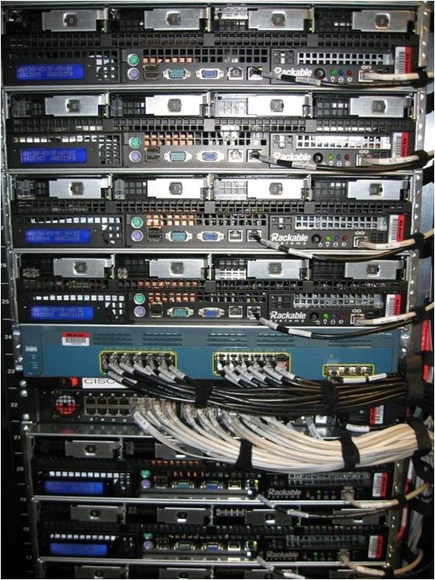

Availability sets
Compute
Storage
Networking
Management
Physical machines
Power unit
Rack switch
VM1
VM2
VM2
VM1
Availability set

Slide 14
Moving VMs to Azure
Compute
Storage
Networking
Management
Start VMs and app development in Azure
Your datacenter, or your hoster
Move VHDs if you’re running Hyper-V on-premises
For VMWare users, Azure Site Recovery is a great approach!
Production environment
Notes:
Once everything is developed and tested, you o course have the choice of running in Azure or bringing it back to production environment on your premises.
If that’s the case, moving the deployment is easy. Because Azure VMs use the exact same format as the Windows Server Hyper-V i.e. VHD. So if it runs on Hyper-V it runs in Azure and vice-versa. In fact, Azure is built on the same foundation as Windows Server 2012!
This is unique for us. Other public cloud vendors will convert the image into proprietary formats and it becomes hard to convert back.
If you have your on-premises environment on a different platform other than Hyper-V, the Microsoft Virtual Machine Converter (MVMC) Solution Accelerator is a Microsoft-supported, stand-alone solution to convert VMware-based virtual machines and disks to Hyper-V®-based virtual machines and disks.
How about management? While you can use the Azure management portal, you can also use the familiar System Center 2012 management console. System Center 2012 introduced the App Controller component to enable organizations to optimize resource usage across their private cloud and Azure resources from a single pane of glass. In SP1, we’ve extended App Controller’s capabilities to integrate with Windows Azure Virtual Machines enabling you to migrate on-premises Virtual Machines to run in Windows Azure and manage them from your on-premises System Center installation.

Slide 15

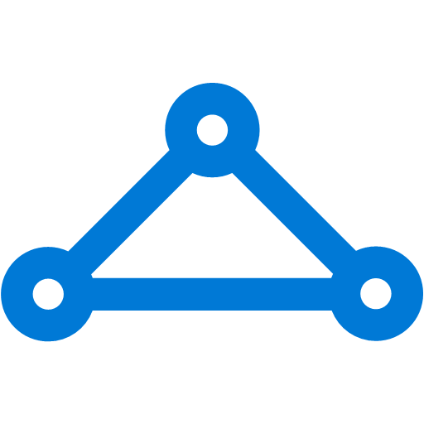
Azure Networking
Compute
Storage
Networking
Management
Virtual network
Private IP addresses, Network-level isolation
Segment with subnets and security groups
Control traffic flow with user-defined routes
Internet access
Azure virtual network
ExpressRoute
VPN gateways
Hybrid connectivity
Point-to-site for dev/test
VPN gateways for secure site-to-site connectivity
ExpressRoute for private enterprise grade connectivity
Domain-join with on-premises
Notes:
Virtual network
Azure virtual network closely resembles a traditional network that you'd operate in your own data center, with the benefits of using the scalable infrastructure.
Azure Virtual Network provides an isolated and secure environment to run your virtual machines and applications. You can use your private IP addresses and define subnets, access control policies, and more. With Virtual Networks, you can treat Azure just as you would your own datacenter.
Traffic between Azure resources, whether in a single region, or in multiple regions, stays in the Azure network. Intra-Azure traffic does not flow over the Internet. For example, within Azure, traffic for VM-to-VM, storage, and SQL communication traverses only the Azure network, regardless of the source and destination Azure region
With Virtual Network, you can easily extend your on-premises IT environment into the cloud, much the way that you can set up and connect to a remote branch office. You have multiple options to securely connect to a Virtual Network—you can choose an IPSec VPN or a private connection using the Azure ExpressRoute service.
Within a virtual network, you can choose to run a variety of network virtual appliances—WAN optimizers, load balancers, and application firewalls—and define traffic flows, allowing you to design the network with a greater degree of control.
Azure VPN Gateway connects your on-premises networks to Azure through site-to-site VPNs, much the way you’d set up and connect to a remote branch office. The connectivity is secure, using industry standard protocols: Internet Protocol Security (IPsec) and Internet Key Exchange (IKE).
Point-to-site VPN lets you connect to your virtual machines on Azure virtual networks from anywhere, whether you are on the road or working from your favorite café, managing your deployment, or doing a demo for your customers.
With Azure DNS, you can host your DNS domains in Azure. Manage your DNS records using the same credentials and billing and support contract as your other Azure services. Seamlessly integrate Azure-based services with corresponding DNS updates, streamlining the end-to-end deployment process.
Azure ExpressRoute lets you create private connections between Azure datacenters and infrastructure on your premises or in a colocation environment. ExpressRoute connections don't go over the public Internet. They offer more reliability, faster speeds, and lower latencies, and higher security than typical Internet connections.
It is your private network isolated from other virtual networks in the Azure cloud infrastructure. You can launch VMs, select its IP range, create subnets, network setting and security groups
Subnet is a range of addresses assigned to your Virtual network
Connectivity:
You can connect your virtual network to your own corporate data center using an IPSec hardware VPN connection. It is a secure bridge between your existing IT infra and Azure cloud using an encrypted VPN connection
All communications for VMs running within your virtual network and outside is routed through the VPN connection
With user defined routes and VPN gateways– you can route all traffic to and from the internet and VPN gateway
Network ACLs (Access control list) – allow and deny rules, full control of traffic
You can reserved IP addresses
Load balancing for higher availability

Slide 16


Virtual Network
Compute
Storage
Networking
Management
Your virtual branch office/data center in the cloud
Allows customers to extend their Enterprise Networks into Microsoft Azure
Networking on-ramp for migrating existing apps and services to Microsoft Azure
Allows customers to run hybrid apps that span the cloud and their on-premises setup
A protected private virtual network in the cloud
Logical isolation with control over network
Create subnets with your private IP addresses
Stable and persistent private IP addresses
Azure
Backend
10.3/16
Mid-tier
10.2/16
Frontend
10.1/16
AD / DNS
Virtual Network
Notes:
Virtual network
Azure virtual network closely resembles a traditional network that you'd operate in your own data center, with the benefits of using the scalable infrastructure.
Azure Virtual Network provides an isolated and secure environment to run your virtual machines and applications. You can use your private IP addresses and define subnets, access control policies, and more. With Virtual Networks, you can treat Azure just as you would your own datacenter.
Traffic between Azure resources, whether in a single region, or in multiple regions, stays in the Azure network. Intra-Azure traffic does not flow over the Internet. For example, within Azure, traffic for VM-to-VM, storage, and SQL communication traverses only the Azure network, regardless of the source and destination Azure region
With Virtual Network, you can easily extend your on-premises IT environment into the cloud, much the way that you can set up and connect to a remote branch office. You have multiple options to securely connect to a Virtual Network—you can choose an IPSec VPN or a private connection using the Azure ExpressRoute service.
Within a virtual network, you can choose to run a variety of network virtual appliances—WAN optimizers, load balancers, and application firewalls—and define traffic flows, allowing you to design the network with a greater degree of control.
Azure VPN Gateway connects your on-premises networks to Azure through site-to-site VPNs, much the way you’d set up and connect to a remote branch office. The connectivity is secure, using industry standard protocols: Internet Protocol Security (IPsec) and Internet Key Exchange (IKE).
Point-to-site VPN lets you connect to your virtual machines on Azure virtual networks from anywhere, whether you are on the road or working from your favorite café, managing your deployment, or doing a demo for your customers.
With Azure DNS, you can host your DNS domains in Azure. Manage your DNS records using the same credentials and billing and support contract as your other Azure services. Seamlessly integrate Azure-based services with corresponding DNS updates, streamlining the end-to-end deployment process.
Azure ExpressRoute lets you create private connections between Azure datacenters and infrastructure on your premises or in a colocation environment. ExpressRoute connections don't go over the public Internet. They offer more reliability, faster speeds, and lower latencies, and higher security than typical Internet connections.
It is your private network isolated from other virtual networks in the Azure cloud infrastructure. You can launch VMs, select its IP range, create subnets, network setting and security groups
Subnet is a range of addresses assigned to your Virtual network
Connectivity:
You can connect your virtual network to your own corporate data center using an IPSec hardware VPN connection. It is a secure bridge between your existing IT infra and Azure cloud using an encrypted VPN connection
All communications for VMs running within your virtual network and outside is routed through the VPN connection
With user defined routes and VPN gateways– you can route all traffic to and from the internet and VPN gateway
Network ACLs (Access control list) – allow and deny rules, full control of traffic
You can reserved IP addresses
Load balancing for higher availability

Slide 17
Network Security Groups
Compute
Storage
Networking
Management
Segment network to meet security needs
5 tuple ACLs on both directions
Can protect Internet and internal traffic
Enables DMZ subnets
Associated to subnets/VMs and now NICs
ACLs can be updated independent of VMs
On Premises 10.0/16
Internet
ExpressRoute and VPNs
√
√
√
√
VPN GW
Backend
10.3/16
Mid-tier
10.2/16
Frontend
10.1/16
Virtual Network
Notes:
Virtual network
Azure virtual network closely resembles a traditional network that you'd operate in your own data center, with the benefits of using the scalable infrastructure.
Azure Virtual Network provides an isolated and secure environment to run your virtual machines and applications. You can use your private IP addresses and define subnets, access control policies, and more. With Virtual Networks, you can treat Azure just as you would your own datacenter.
Traffic between Azure resources, whether in a single region, or in multiple regions, stays in the Azure network. Intra-Azure traffic does not flow over the Internet. For example, within Azure, traffic for VM-to-VM, storage, and SQL communication traverses only the Azure network, regardless of the source and destination Azure region
With Virtual Network, you can easily extend your on-premises IT environment into the cloud, much the way that you can set up and connect to a remote branch office. You have multiple options to securely connect to a Virtual Network—you can choose an IPSec VPN or a private connection using the Azure ExpressRoute service.
Within a virtual network, you can choose to run a variety of network virtual appliances—WAN optimizers, load balancers, and application firewalls—and define traffic flows, allowing you to design the network with a greater degree of control.
Azure VPN Gateway connects your on-premises networks to Azure through site-to-site VPNs, much the way you’d set up and connect to a remote branch office. The connectivity is secure, using industry standard protocols: Internet Protocol Security (IPsec) and Internet Key Exchange (IKE).
Point-to-site VPN lets you connect to your virtual machines on Azure virtual networks from anywhere, whether you are on the road or working from your favorite café, managing your deployment, or doing a demo for your customers.
With Azure DNS, you can host your DNS domains in Azure. Manage your DNS records using the same credentials and billing and support contract as your other Azure services. Seamlessly integrate Azure-based services with corresponding DNS updates, streamlining the end-to-end deployment process.
Azure ExpressRoute lets you create private connections between Azure datacenters and infrastructure on your premises or in a colocation environment. ExpressRoute connections don't go over the public Internet. They offer more reliability, faster speeds, and lower latencies, and higher security than typical Internet connections.
It is your private network isolated from other virtual networks in the Azure cloud infrastructure. You can launch VMs, select its IP range, create subnets, network setting and security groups
Subnet is a range of addresses assigned to your Virtual network
Connectivity:
You can connect your virtual network to your own corporate data center using an IPSec hardware VPN connection. It is a secure bridge between your existing IT infra and Azure cloud using an encrypted VPN connection
All communications for VMs running within your virtual network and outside is routed through the VPN connection
With user defined routes and VPN gateways– you can route all traffic to and from the internet and VPN gateway
Network ACLs (Access control list) – allow and deny rules, full control of traffic
You can reserved IP addresses
Load balancing for higher availability

Slide 18
Azure Load Balancer
Compute
Storage
Networking
Management
Software based Layer-4 type load balancer
SLB distributes incoming traffic load among healthy service instances in cloud services or VMs defined in a load balancer set
Hash based 2, 3 or 5 tuple algorithm
Provide routing/access to instances from the Internet
Provide outbound internet connectivity from Azure with address translation
Client 1
Client 2
Source IP based distribution
VIP
Azure Load Balancer
Availability set
Server 1
Server 2
Notes:
Virtual network
Azure virtual network closely resembles a traditional network that you'd operate in your own data center, with the benefits of using the scalable infrastructure.
Azure Virtual Network provides an isolated and secure environment to run your virtual machines and applications. You can use your private IP addresses and define subnets, access control policies, and more. With Virtual Networks, you can treat Azure just as you would your own datacenter.
Traffic between Azure resources, whether in a single region, or in multiple regions, stays in the Azure network. Intra-Azure traffic does not flow over the Internet. For example, within Azure, traffic for VM-to-VM, storage, and SQL communication traverses only the Azure network, regardless of the source and destination Azure region
With Virtual Network, you can easily extend your on-premises IT environment into the cloud, much the way that you can set up and connect to a remote branch office. You have multiple options to securely connect to a Virtual Network—you can choose an IPSec VPN or a private connection using the Azure ExpressRoute service.
Within a virtual network, you can choose to run a variety of network virtual appliances—WAN optimizers, load balancers, and application firewalls—and define traffic flows, allowing you to design the network with a greater degree of control.
Azure VPN Gateway connects your on-premises networks to Azure through site-to-site VPNs, much the way you’d set up and connect to a remote branch office. The connectivity is secure, using industry standard protocols: Internet Protocol Security (IPsec) and Internet Key Exchange (IKE).
Point-to-site VPN lets you connect to your virtual machines on Azure virtual networks from anywhere, whether you are on the road or working from your favorite café, managing your deployment, or doing a demo for your customers.
With Azure DNS, you can host your DNS domains in Azure. Manage your DNS records using the same credentials and billing and support contract as your other Azure services. Seamlessly integrate Azure-based services with corresponding DNS updates, streamlining the end-to-end deployment process.
Azure ExpressRoute lets you create private connections between Azure datacenters and infrastructure on your premises or in a colocation environment. ExpressRoute connections don't go over the public Internet. They offer more reliability, faster speeds, and lower latencies, and higher security than typical Internet connections.
It is your private network isolated from other virtual networks in the Azure cloud infrastructure. You can launch VMs, select its IP range, create subnets, network setting and security groups
Subnet is a range of addresses assigned to your Virtual network
Connectivity:
You can connect your virtual network to your own corporate data center using an IPSec hardware VPN connection. It is a secure bridge between your existing IT infra and Azure cloud using an encrypted VPN connection
All communications for VMs running within your virtual network and outside is routed through the VPN connection
With user defined routes and VPN gateways– you can route all traffic to and from the internet and VPN gateway
Network ACLs (Access control list) – allow and deny rules, full control of traffic
You can reserved IP addresses
Load balancing for higher availability

Slide 19
Azure Resource Manager (ARM)
Compute
Storage
Networking
Management
Enable application management within Azure
Resource groups are containers that can contain multiple IaaS + PaaS resources
Support lifecycle management with integrated Role Based Access Control (RBAC)
Templatize application deployment and configuration, supports DevOps
RESOU
R
CE G
R
OUP

Slide 20
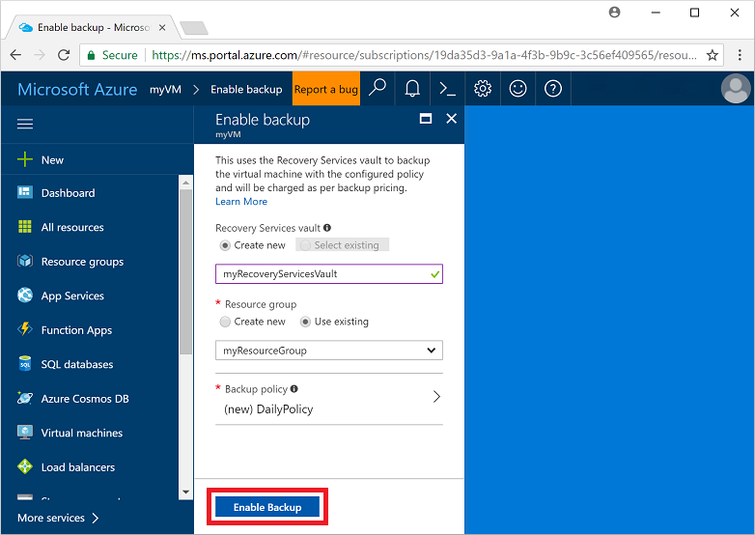
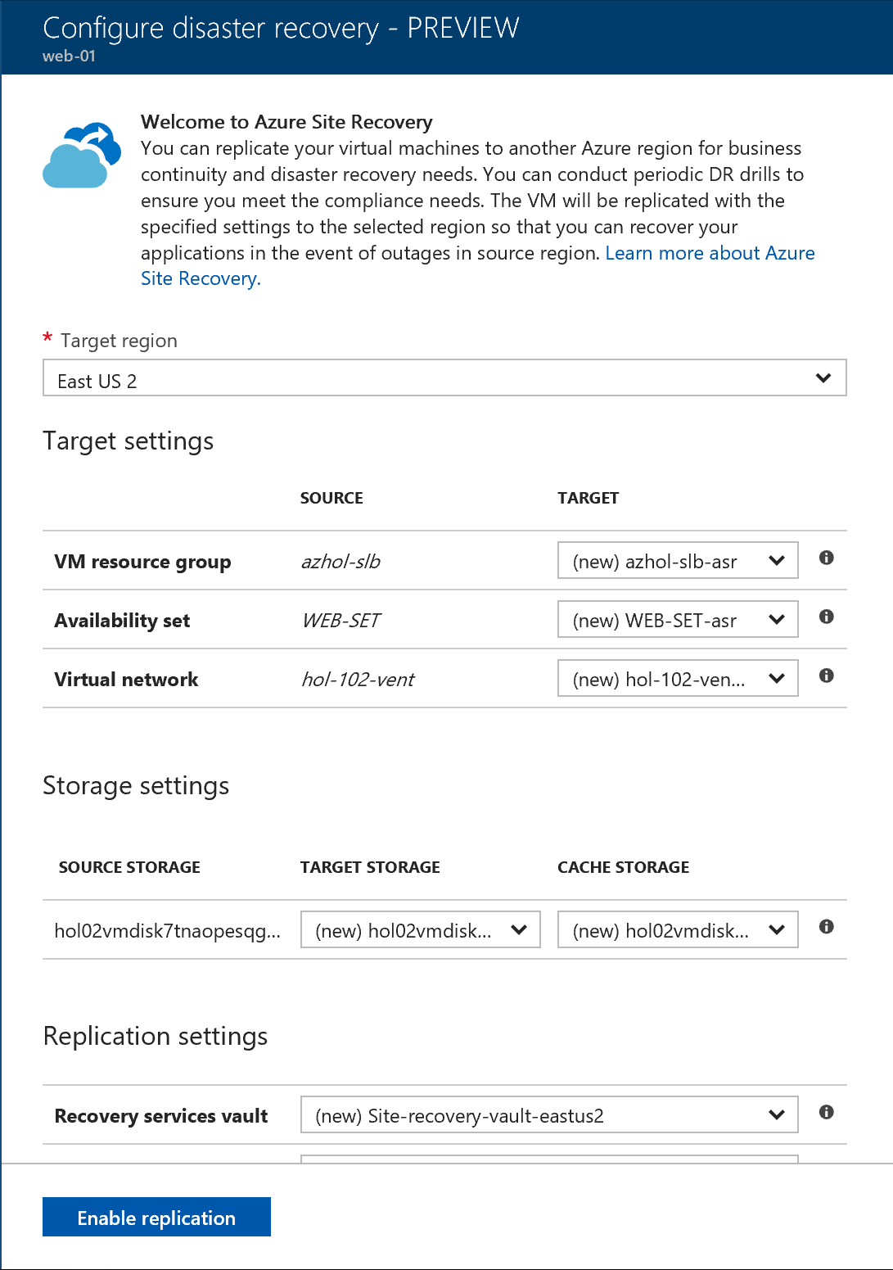
Backup and DR
Compute
Storage
Networking
Management

Slide 21
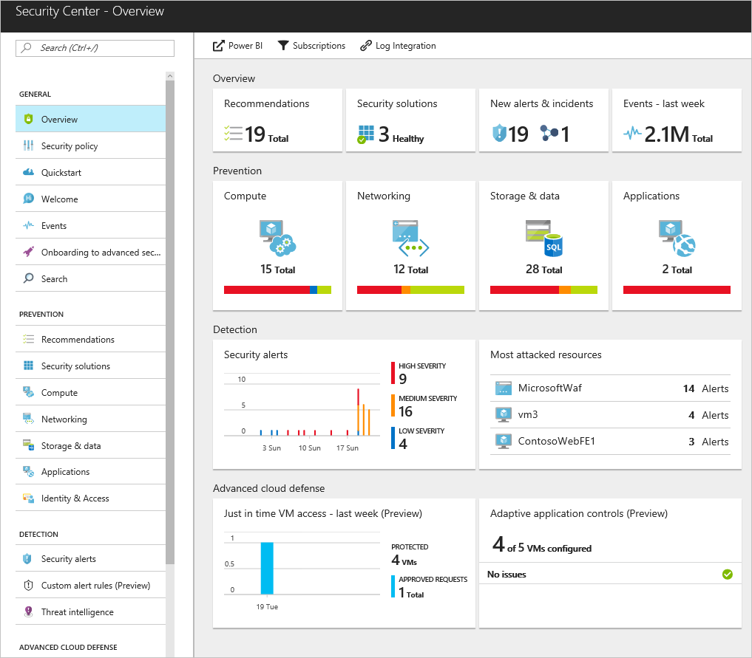
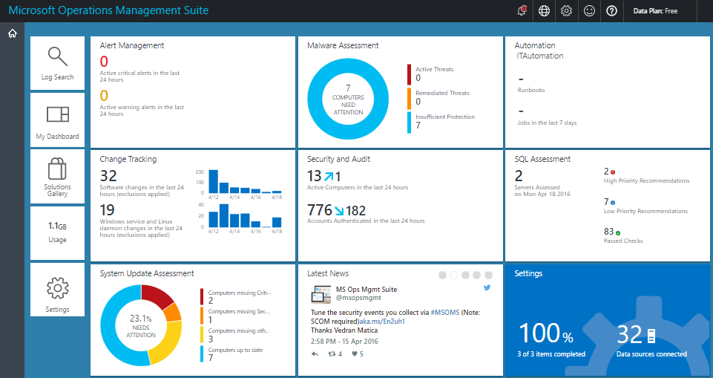
Monitor systems and security
Compute
Storage
Networking
Management

Slide 22
Line of Business Applications
Backup+Archive+DR
Dev/test
LOB apps
Dev/test capabilities
Hybrid and Global reach
Deployment and management ease
Bring existing licenses
Support
Get started with Azure quickly and easily
Enables agile test environments with infrastructure on demand
Seamlessly extend IT to the cloud
Get started with Azure quickly and easily
Best-in-class support for apps and infrastructure
Move apps to Azure without purchasing new Microsoft licenses
Notes:
Speaker Notes:
Run your Microsoft software where it runs the best—Azure. It’s consistency and seamless integration across cloud and on-premises, it’s unique product offerings and capabilities, it’s flexible pricing, and it’s best-in-class support that only Microsoft is uniquely positioned to offer makes Azure the best public cloud for running Microsoft software.
Key reasons why Azure is the best cloud platform for your enterprise apps:
Getting started is quick and painless with deployment and management ease
You can seamlessly expend IT to the cloud with native hybrid capabilities
You receive best-in-class support for your apps and infrastructure
Azure enables agile testing environments with on-demand infrastructure
And license mobility enables you to move workloads to Azure with having to purchase new rights
We will looks at all of these key reasons in detail in the following slides.
Additional Links:
https://azure.microsoft.com/en-us/blog/microsoft-applications-on-azure/
https://azure.microsoft.com/en-us/overview/azure-for-microsoft-software/

Slide 23
Support for Microsoft apps
Dev/test
LOB apps
Backup+Archive+DR
Microsoft BizTalk Server
Microsoft Dynamics AX
Microsoft Dynamics CRM
Microsoft Dynamics GP
Microsoft Dynamics NAV
Microsoft Exchange
Microsoft Forefront Identity Manager
Microsoft HPC Pack
Microsoft Project Server
Microsoft SharePoint Server
Microsoft SQL Server
Microsoft System Center
Microsoft Team Foundation Server
Microsoft Windows Server
SharePoint
SQL Server
Dynamics
Exchange
https://support.microsoft.com/en-ca/kb/2721672
Notes:
-Well tested and tuned
-One “throat to choke”
-One support ecosystem
https://support.microsoft.com/en-ca/kb/2721672

Slide 24

© 2014 Microsoft Corporation. All rights reserved. Microsoft, Windows, and other product names are or may be registered trademarks and/or trademarks in the U.S. and/or other countries.
The information herein is for informational purposes only and represents the current view of Microsoft Corporation as of the date of this presentation. Because Microsoft must respond to changing market conditions, it should not be interpreted to be a commitment on the part of Microsoft, and Microsoft cannot guarantee the accuracy of any information provided after the date of this presentation. MICROSOFT MAKES NO WARRANTIES, EXPRESS, IMPLIED OR STATUTORY, AS TO THE INFORMATION IN THIS PRESENTATION.

